Slide 1
WEST NILE VIRUS
Ravi Mehta

Slide 2

Goal
The goal of this project is to predict where West Nile Virus will show up so we can efficiently and cost-effectively deploy pesticides to combat further spread of the disease.

Slide 3
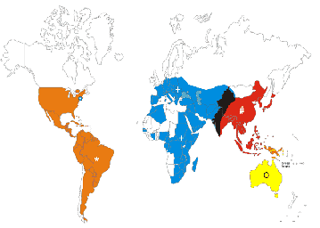
Background
West nile virus was first introduced in the US in the summer of 1999, and spread rapidly until 2002
It is mainly carried by mosquitoes(vector) whose main predator and primary source of blood is birds
http://www.columbia.edu/itc/cerc/danoff-burg/invasion_bio/inv_spp_summ/WestNile.html#Picture%209

Slide 4
West Nile Virus in Chicago
As per the City of Chicago:
“The best way to to prevent WNV disease or any other mosquito-borne illness is to reduce the number of mosquitoes around your home and to take personal precautions to avoid mosquito bites.”
These precautions are listed as
Avoid being outdoors between dusk and dawn
Eliminate all sources of standing water that can support mosquito breeding, including water in bird baths, ponds, flower pots, wading pools, old tires and any other receptacles. ..”
https://www.cityofchicago.org/city/en/depts/cdph/supp_info/infectious/west_nile_virus_surveillancereports2011.html

Slide 5
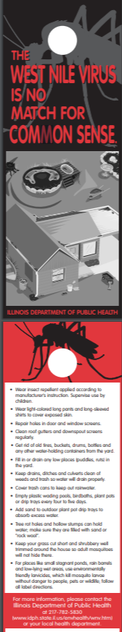
West Nile Virus in Chicago
Tests of the blood of two dead crows signaled the emergence in Illinois in September of 2001
There were 884 cases and 67 deaths by the end of 2002
http://www.dph.illinois.gov/topics-services/diseases-and-conditions/west-nile-virus

Slide 6
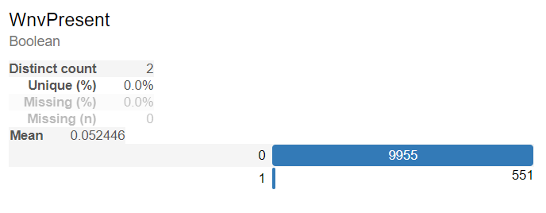
What in Chicago are we looking for?

Slide 7
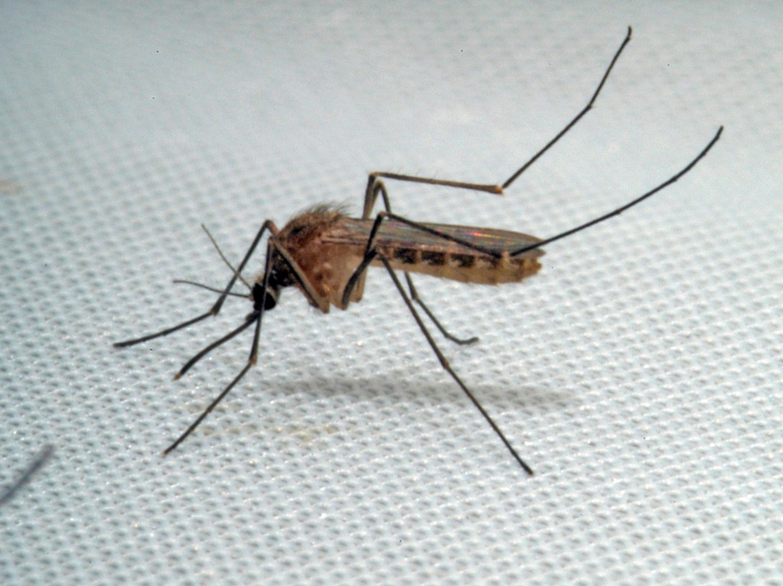
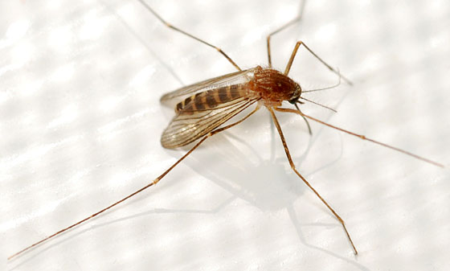
Main Culprit: Mosquitoes
List of Species
Culex Pipiens/Restuans
Culex Pipiens
Culex Restuans
Culex Territans
Culex Salinarius
Culex Tarsalis
Culex Erraticus
2
3
https://research.pasteur.fr/en/culex-pipiens-2-jpg/
https://bugguide.net/node/view/417886

Slide 8
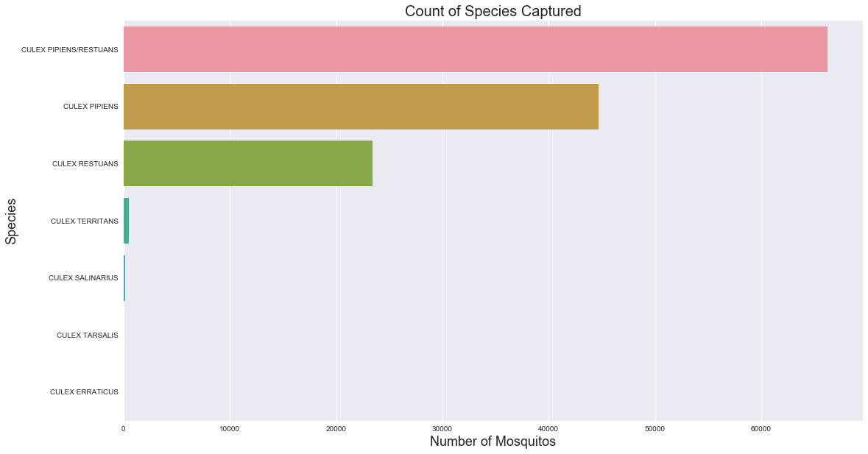

Slide 9
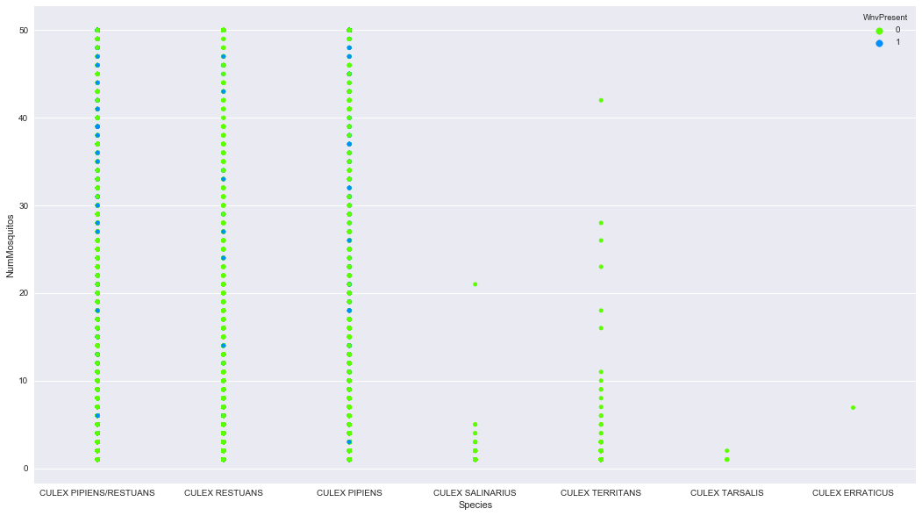
West Nile Virus Distribution by Species Trapped

Slide 10
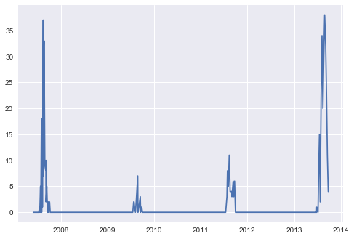
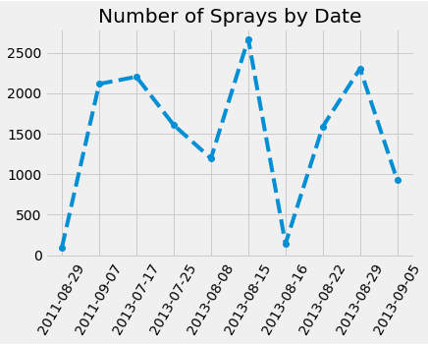
Spray Deployment and WNV Detection
Presence of West Nile by Year

Slide 11
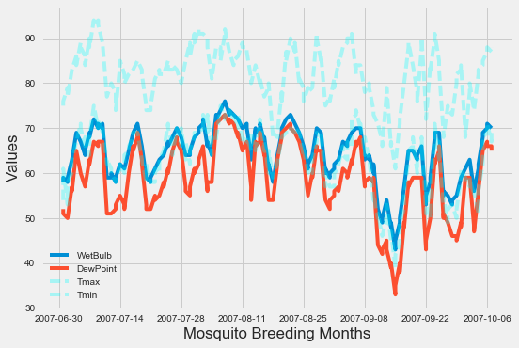
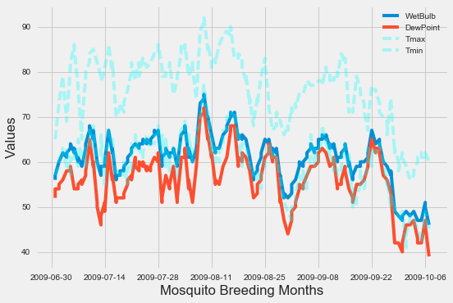
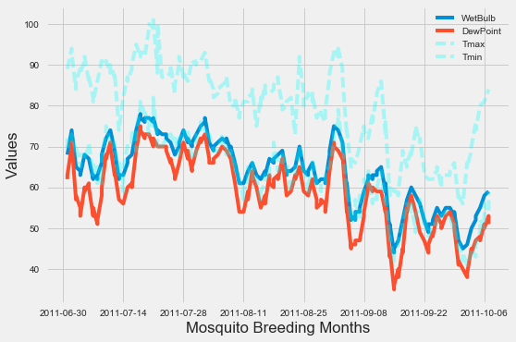
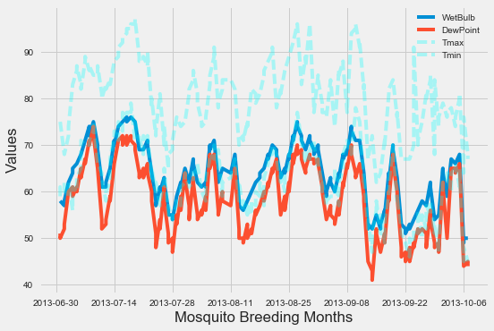
Weather Data

Slide 12

Initial Data Cleaning and Analysis
Complex data sets
Multiple data entries for same data point
Imputing missing values
Two sets of weather data
Used distance metric to determine which weather station to use
Numerous repetitive metrics
Interpreting Dummy variables for weather phenomena

Slide 13
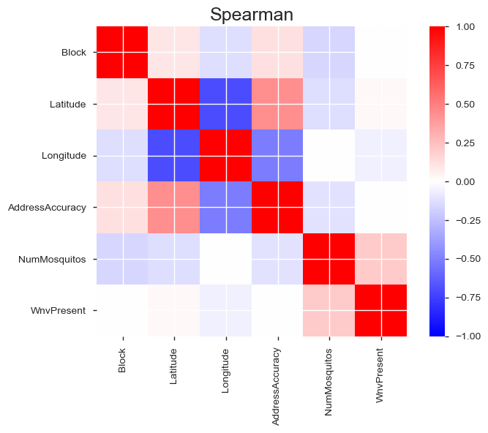
Correlation map

Slide 14
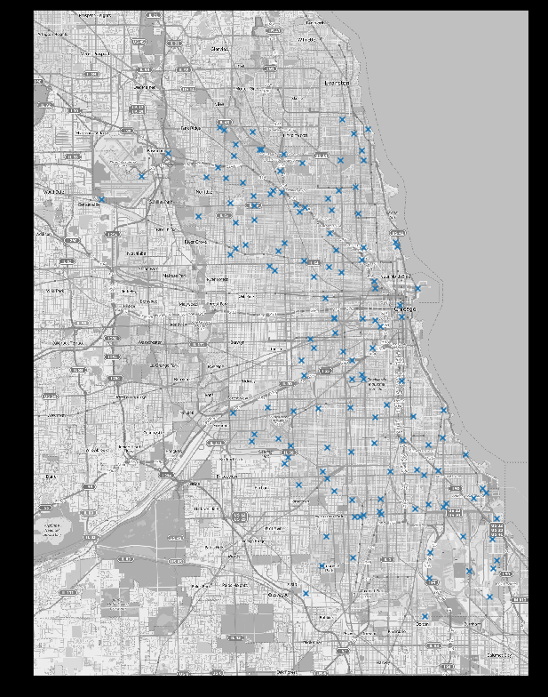
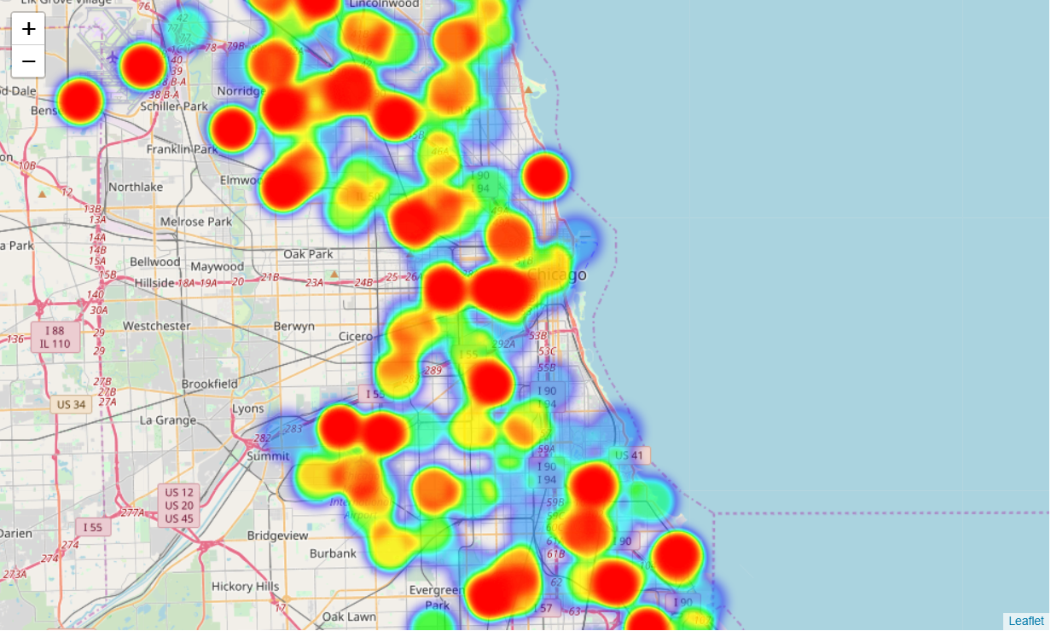
Location of Trap and Heat Map of Positive West Nile cases

Slide 15
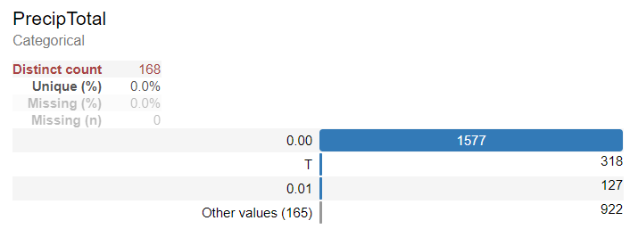
Impacts on Mosquito Activity

Slide 16
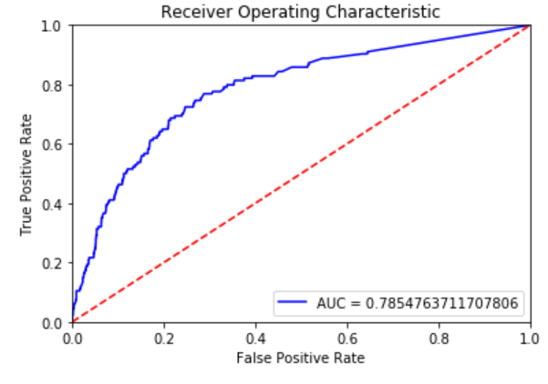
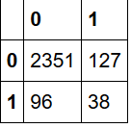
Random Forest Trained on Balanced Classes
Balancing Classes and training a Model is a tricky thing!
We had to split the data into a train set and a holdout set.
On the train set out we balanced the minority WnPresent class
We then fit our model on this data
And we made predictions on the holdout set which was not balanced
actual
True

Slide 17

Neural Network
Initially largely overfit
Significant regularization necessary
Dropout: 0.5
L2 regularization: alpha=0.01
Large batch size: 256
Neurons: 20
Optimizer: Adam
Learning Rate: 0.01
Epochs: 50
Loss function: Binary cross-entropy
Relu
Relu
Sigmoid

Slide 18
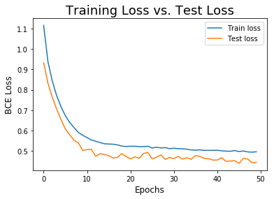
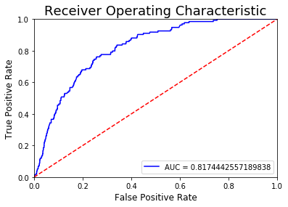
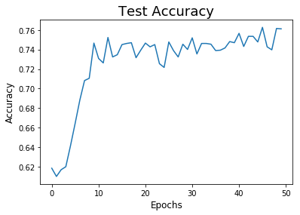
Neural Network
Decent AUC ROC score
Outperformed Random Forest Model

Slide 19
Conclusions & Next Steps
Get more data
Investigate false positives
Simpler approach - predict number of mosquitos
Examine micro-climates is possible
Optimize for sensitivity
Cost to deploy anti-mosquito spray - cost/benefit analysis
Effectiveness
Side effects

